Slide 1
How to order your books for Fall and Spring Semesters on our Online Bookstore https://bncvirtual.com/eureka
Contact the Bookstore at bookstore@eureka.edu if you have any questions
*For Summer or Jumpstart courses please see separate instructions.

Slide 2
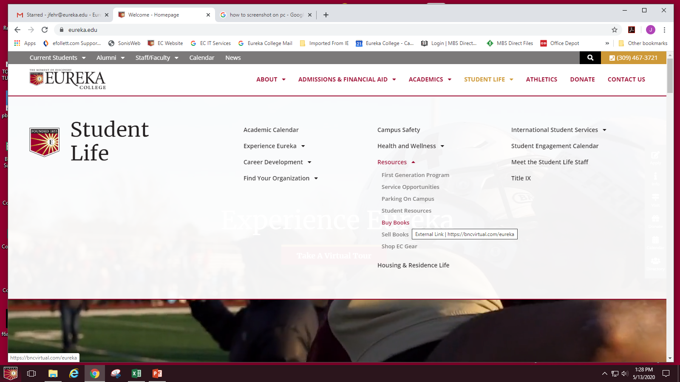
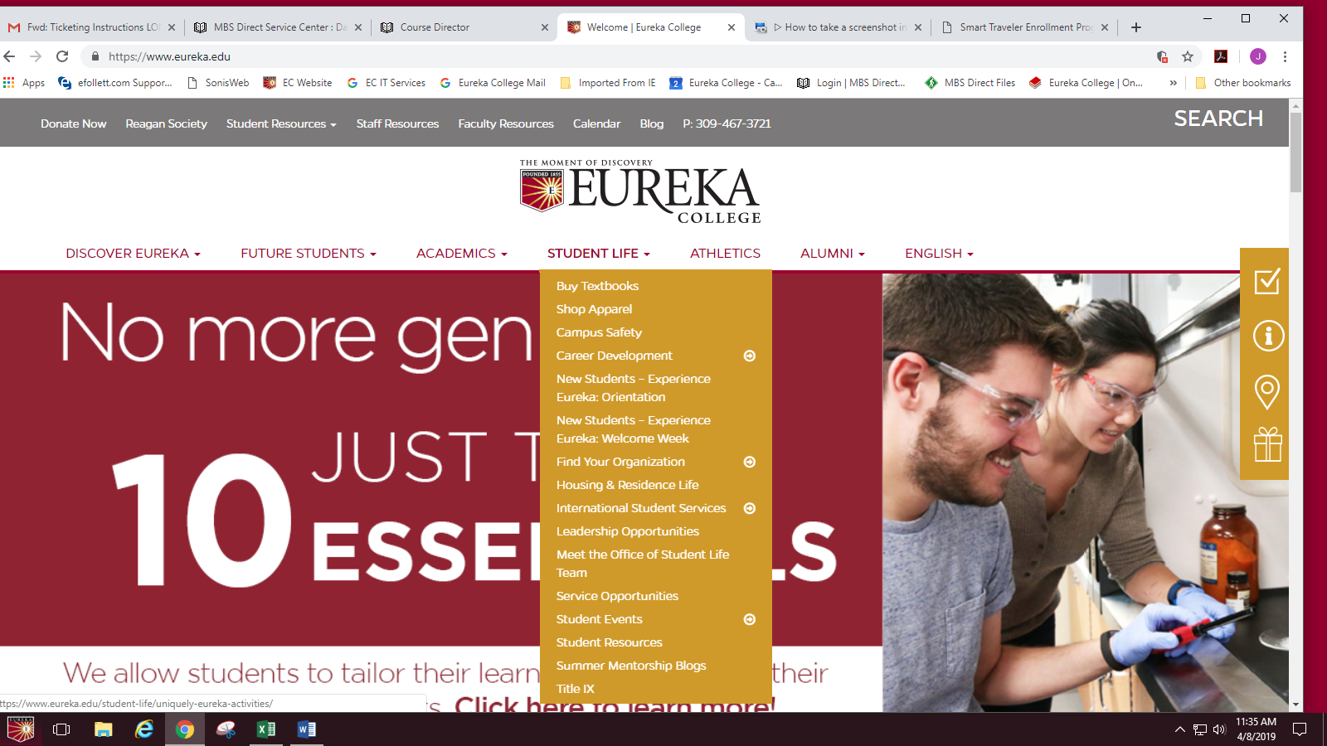

Slide 3
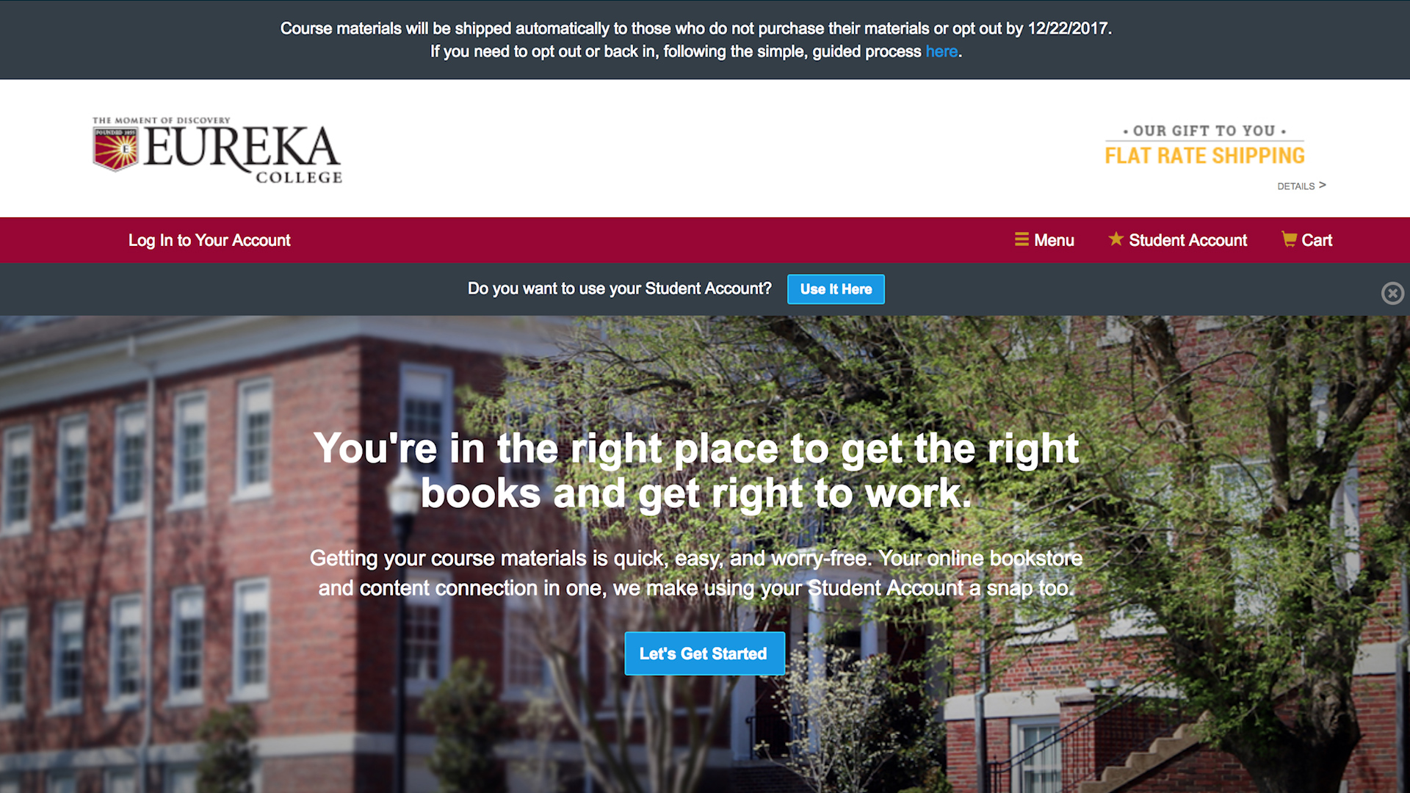

Slide 4
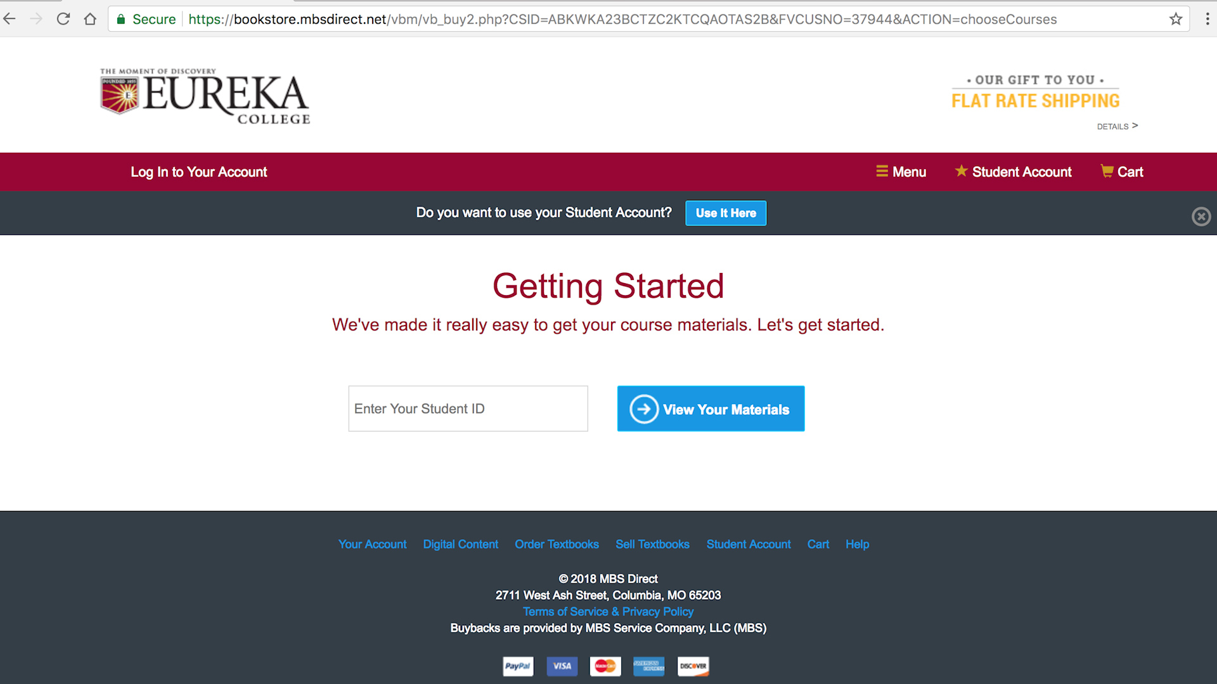

Slide 5
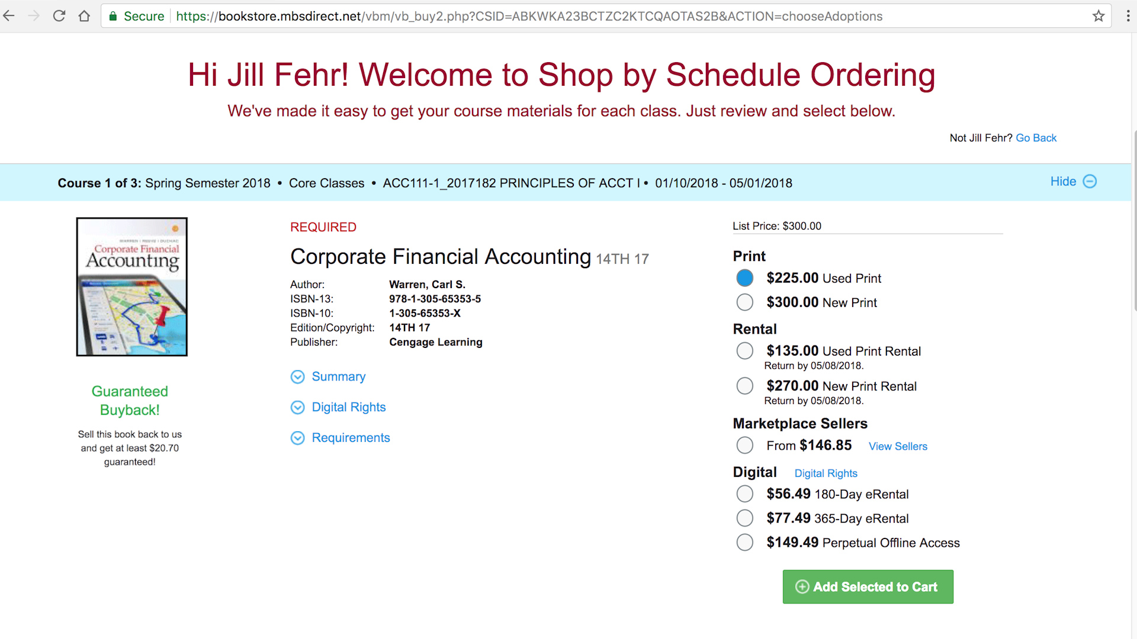

Slide 6
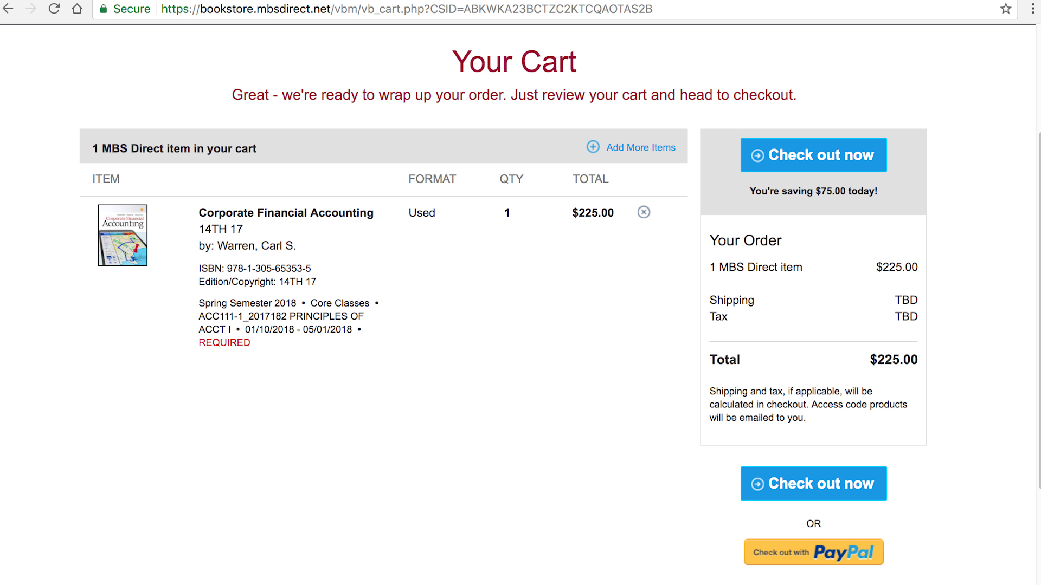

Slide 7
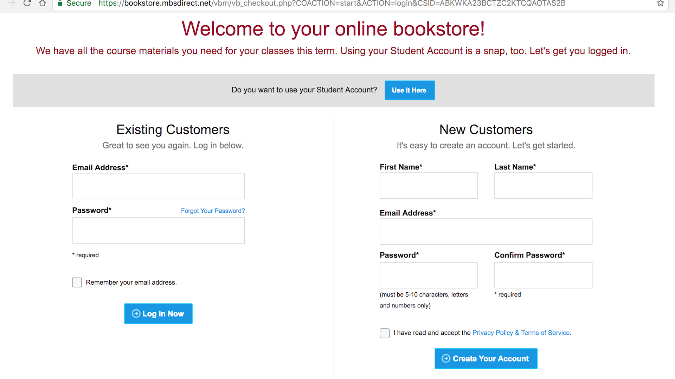

Slide 8
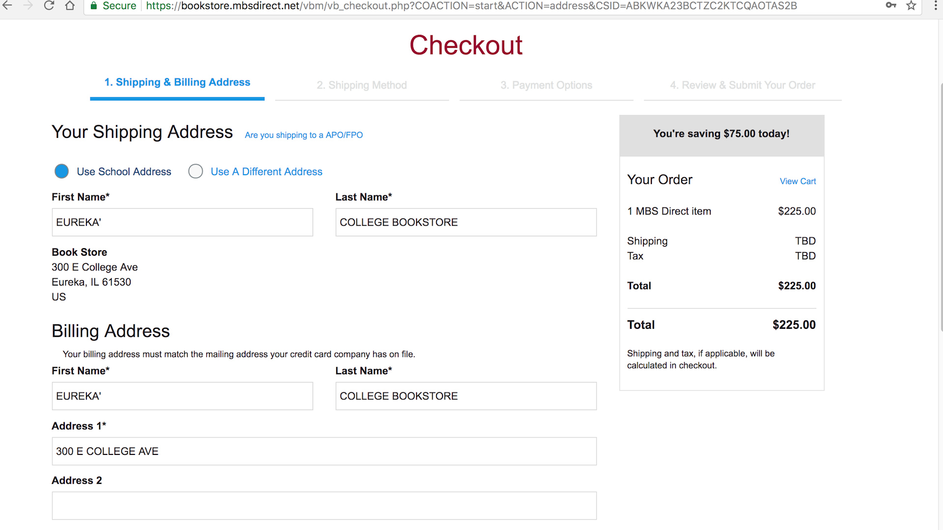

Slide 9
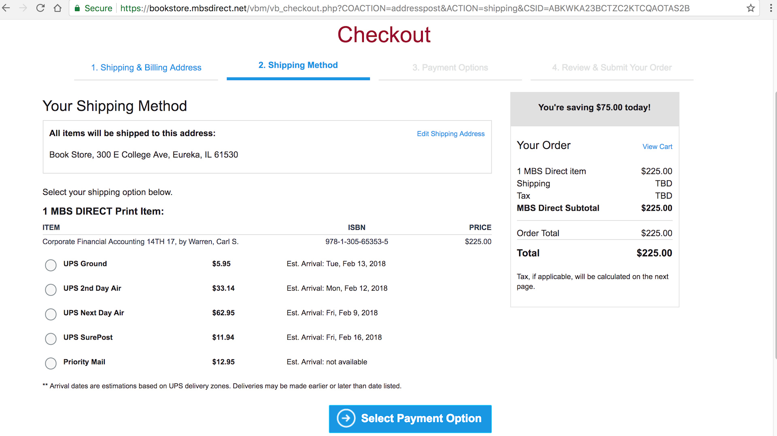

Slide 10
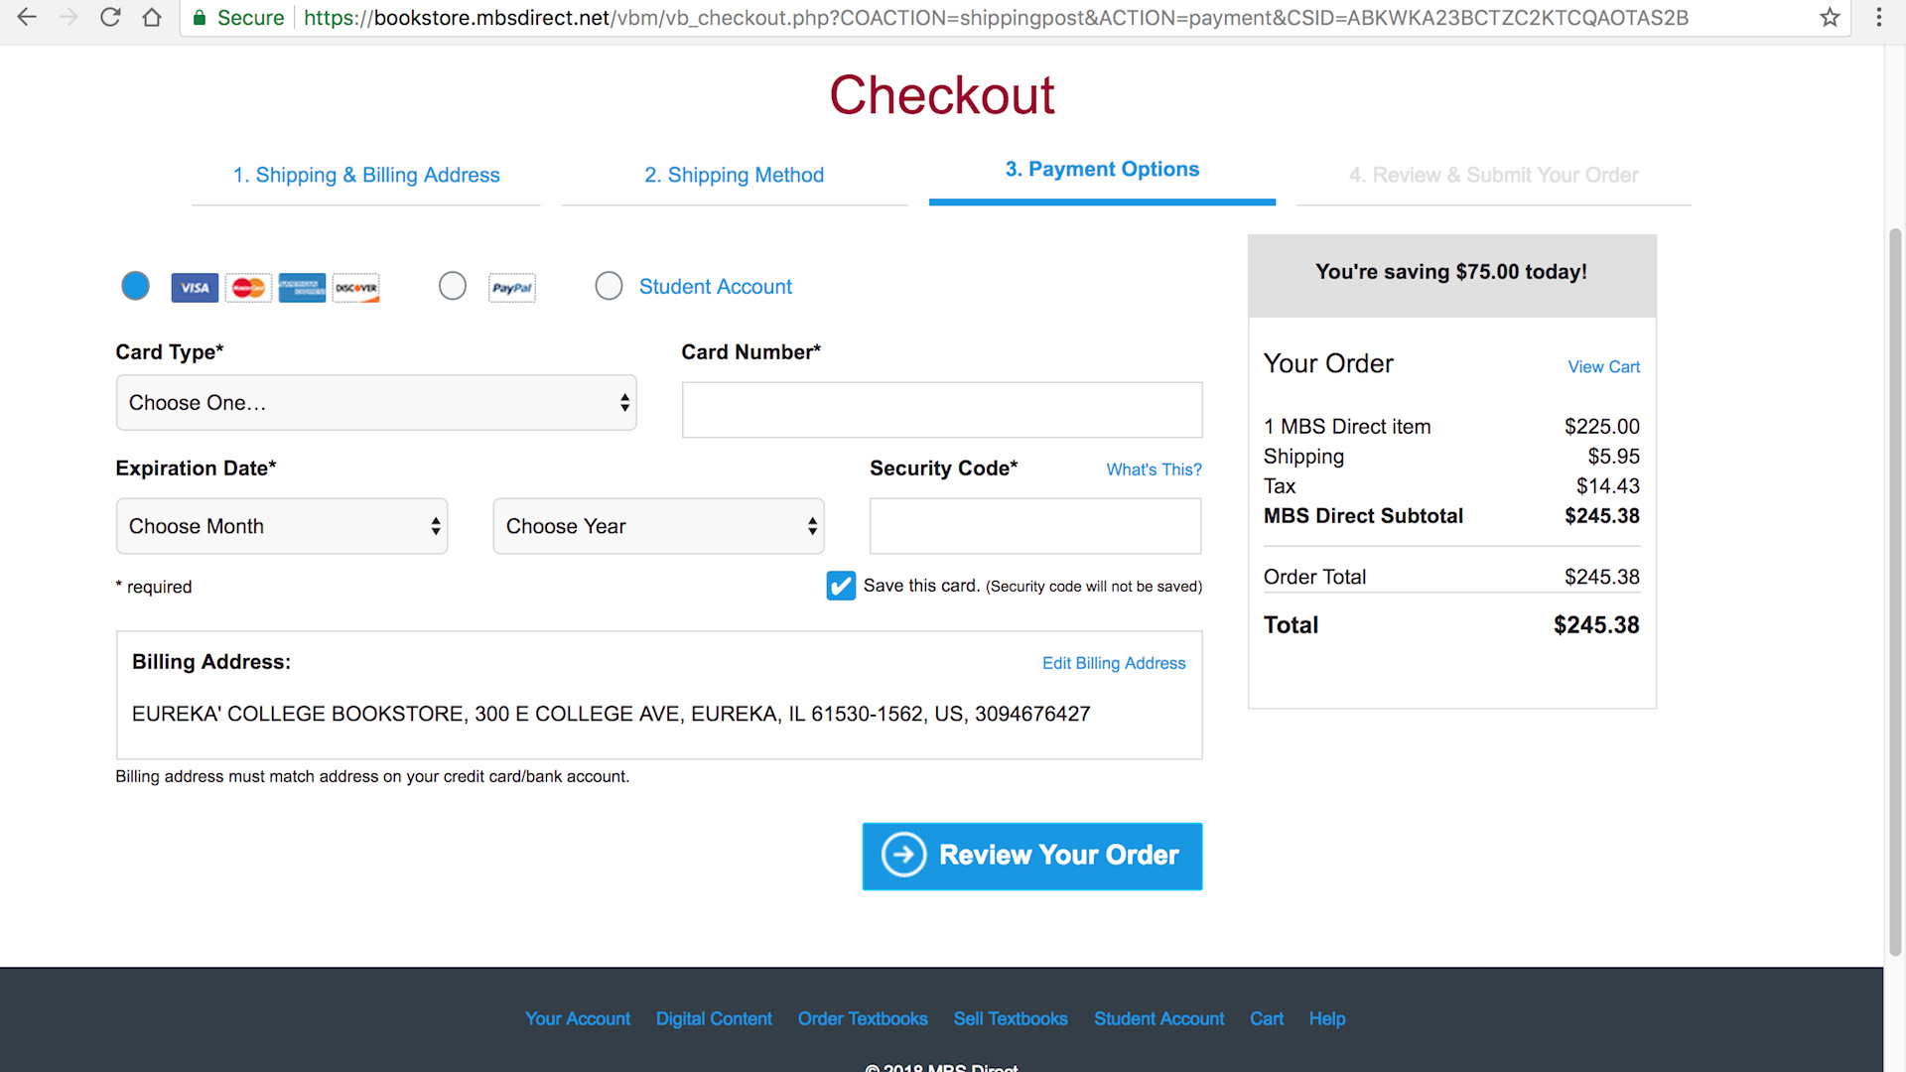

Slide 11
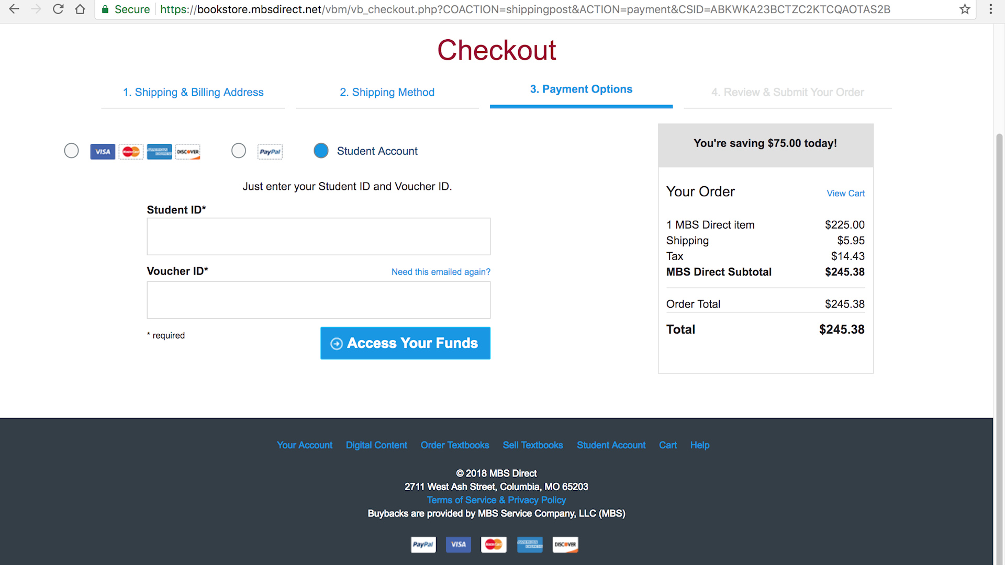

Slide 12
Helpful Reminders:
Watch for emails from the Bookstore
Set up login (Eureka email) and password
Guaranteed Buyback. Guaranteed this price at buyback.
Marketplace books take you out of MBS to Barnes & Noble
Your access ID was sent to you in an email from MBS.
Ship to campus is free before the deadline.
Make sure you hit submit on your order. You will receive an email confirmation.

Slide 13
OPT OUT
IMPORTANT:
Get book information before you opt out.
You can opt back in at any time.
Opt out BEFORE the deadline
Continue on for instructions to opt out

Slide 14
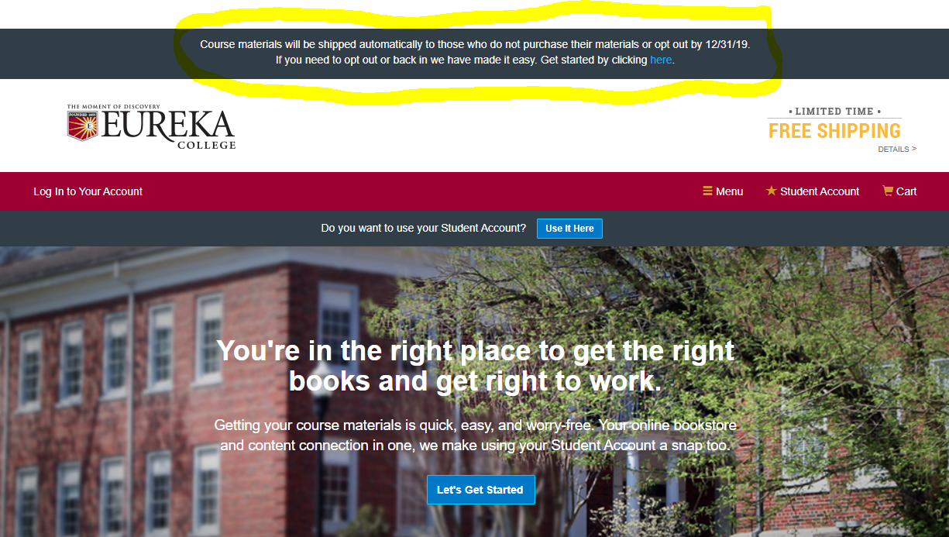

Slide 15
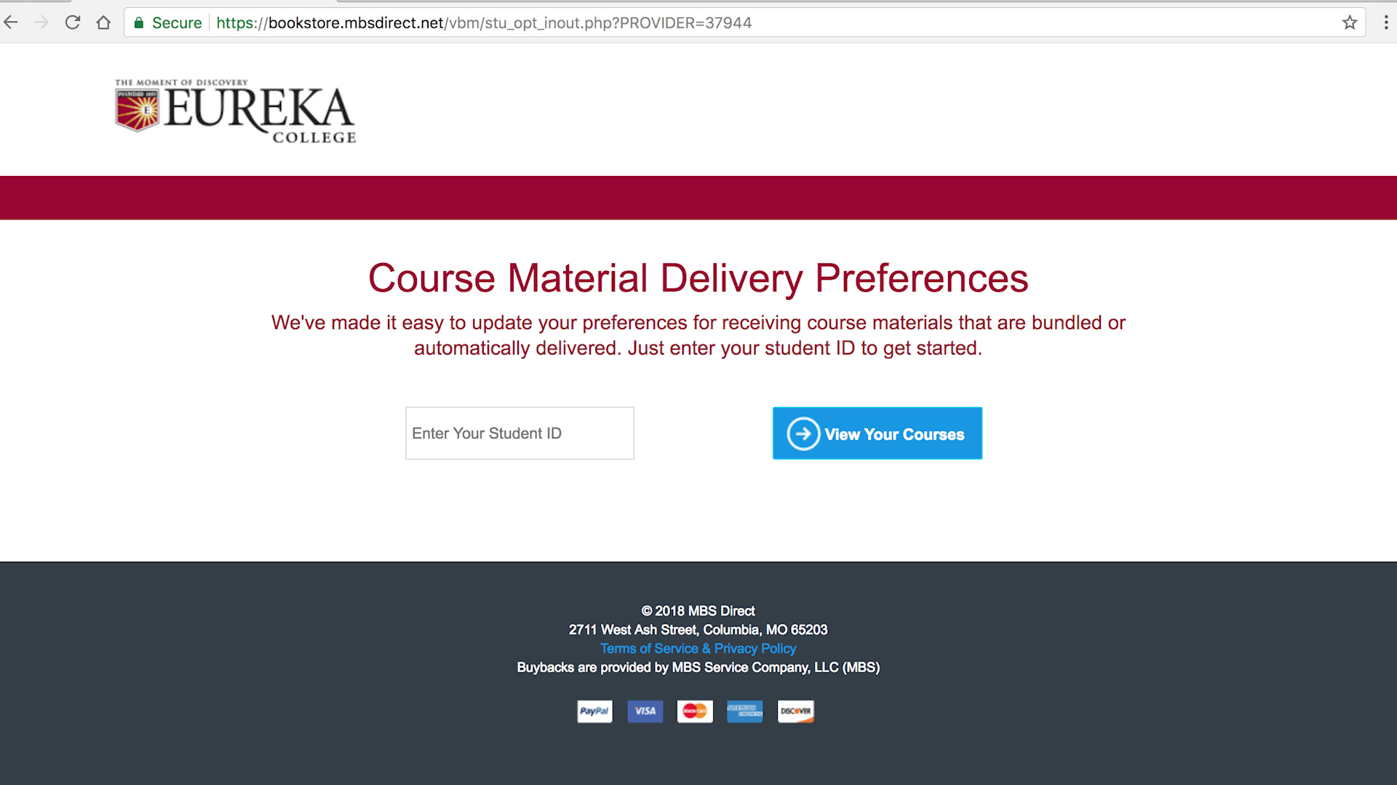

Slide 16
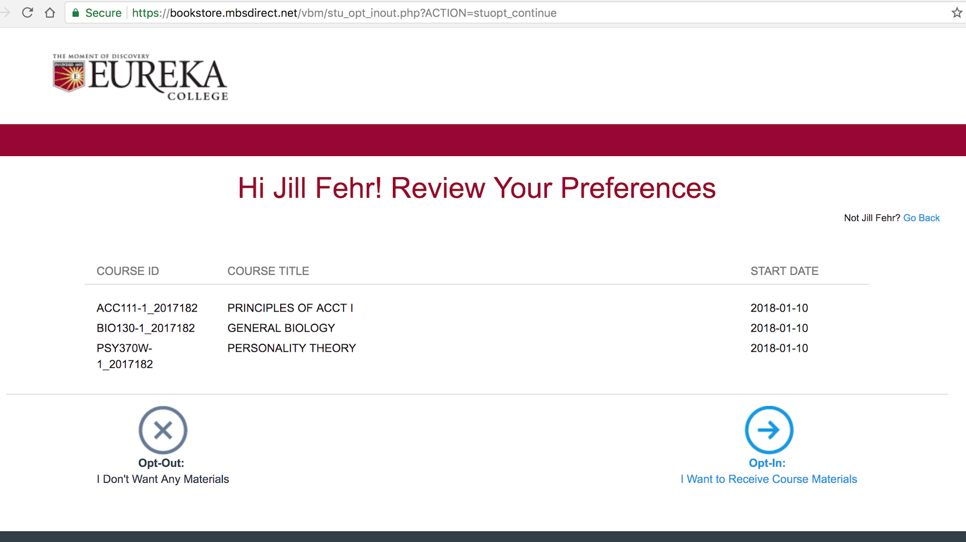

Slide 17
Questions?
bookstore@eureka.edu

